Slide 1

Coefficients of Separated Growth Curve Models 10월 12일
서울대학교 박태성 교수
생물정보통계 연구실
박사과정 구태완 석사과정 한결희, 이도은
학부과정 고영현, 김학용, 김태현, 정혜원

Slide 2
개요
1. Simple Moving Average (window size = 7) 적용
- 주별 시계열 효과(주말에 확진자 감소 또는 확진자 수 0) 보완
2. Separated Logistic, Bertalanffy, Gompertz Model 적합
2020년 08월 31일 기준
3. 각 Model coefficients 비교

Slide 3
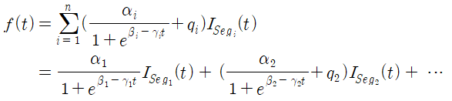
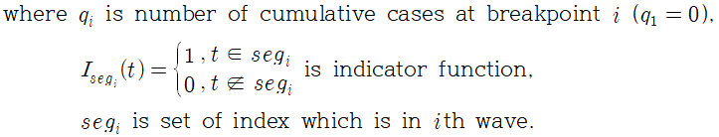
Separated Logistic model
Procedure
1) Peak Detection Algorithm을 이용하여 Breakpoint를 찾음.
2) 각각의 wave partition에 대해 독립적으로 모형을 적합시킴.
=> 함수의 연속성이 보장되지 않음.

Slide 4
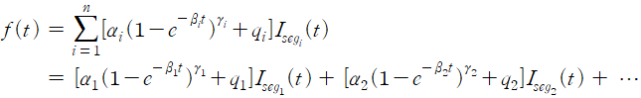
Separated Bertalanffy model
Procedure
1) Peak Detection Algorithm을 이용하여 Breakpoint를 찾음.
2) 각각의 wave partition에 대해 독립적으로 모형을 적합시킴.
=> 함수의 연속성이 보장되지 않음.

Slide 5
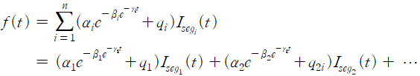
Separated Gompertz model
Procedure
1) Peak Detection Algorithm을 이용하여 Breakpoint를 찾음.
2) 각각의 wave partition에 대해 독립적으로 모형을 적합시킴.
=> 함수의 연속성이 보장되지 않음.

Slide 6
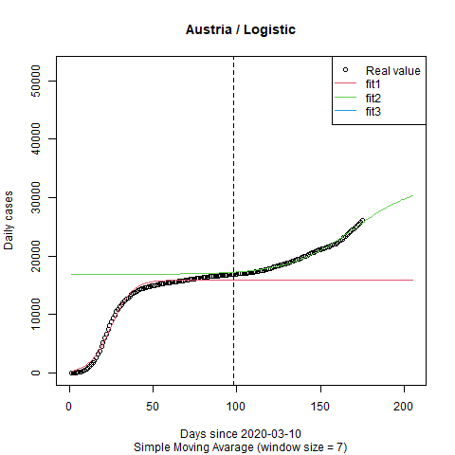
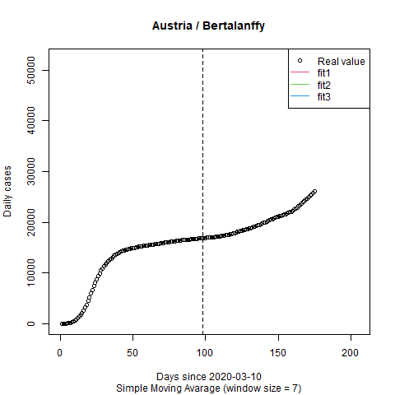
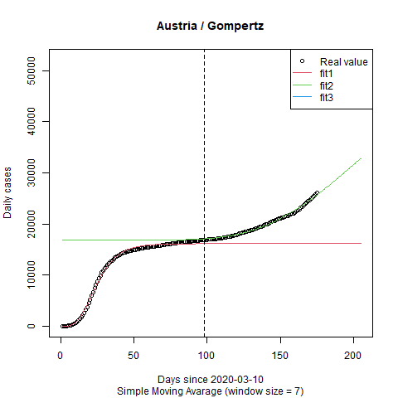
a b c
1 15928.38 3.938720 0.15841061
2 15617.49 8.757085 0.05147723
a b c
1 16168.56 8.857293 0.10436962
2 43923.83 23.548031 0.01534153

Slide 7
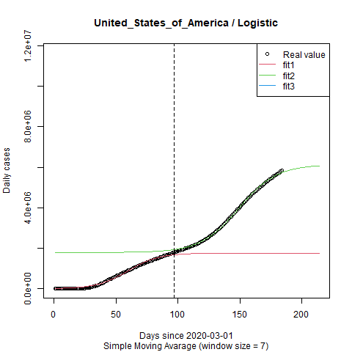
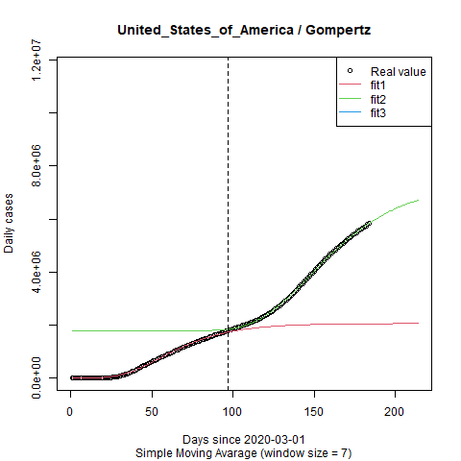
a b c
1 1757174 4.806800 0.08031902
2 4340552 9.708547 0.06511740
a b c
1 2058204 10.39482 0.04218495
2 5588984 92.99743 0.03080245

Slide 8
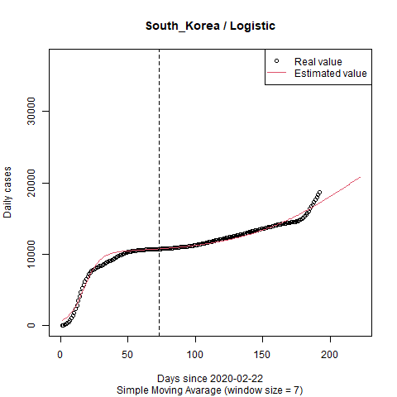
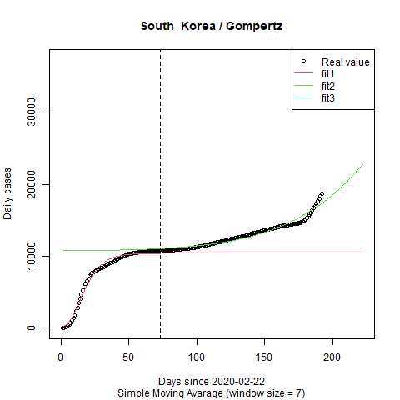
a b c
1 10201.67 2.935827 0.16894476
a b c
1 10403.53 4.799167 0.11301198
2 5615982.08 12.248195 0.003107405

Slide 9
Coefficients for 1st segmentation
For all 3 Growth Curve Model (Logistic / Bertalanffy / Gompertz),
- 16 countries had been fitted commonly
"Belgium" "Croatia" "Denmark" "Estonia" "Finland" "Iceland" "Jamaica" "Lithuania" "Luxembourg" "Malta" "New_Zealand” "Somalia" "South_Korea" "Spain" "Thailand" "Tunisia"

Slide 10
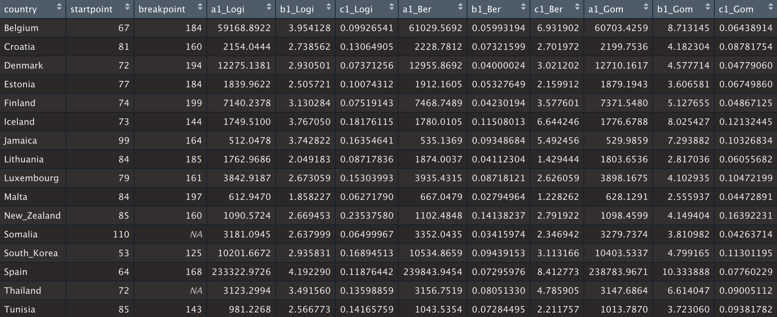
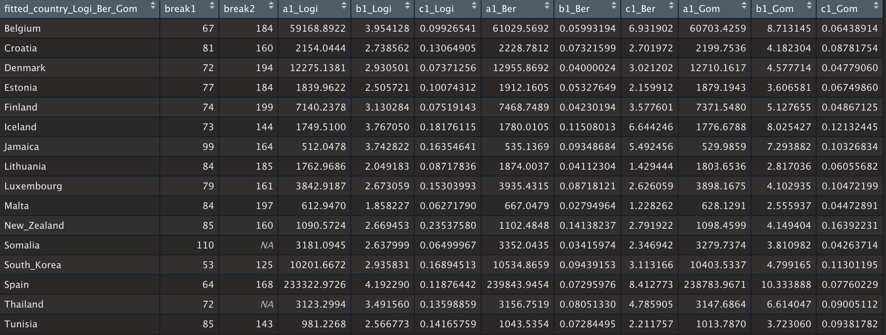
∞

Slide 11
Coefficients for 2st segmentation
For all 3 Growth Curve Model (Logistic / Bertalanffy / Gompertz),
- 0 countries had been fitted commonly

Slide 12
Coefficients for 1st segmentation
For 2 Growth Curve Model (Logistic / Gompertz),
- 124 countries had been fitted commonly

Slide 13
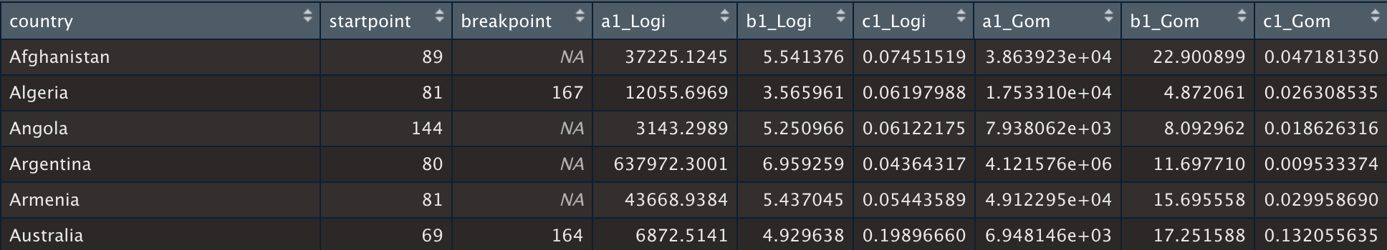
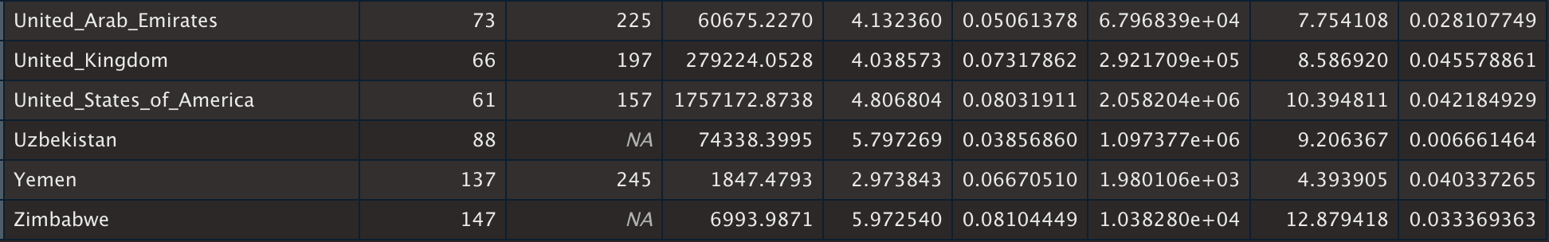
. . . . . .

Slide 14
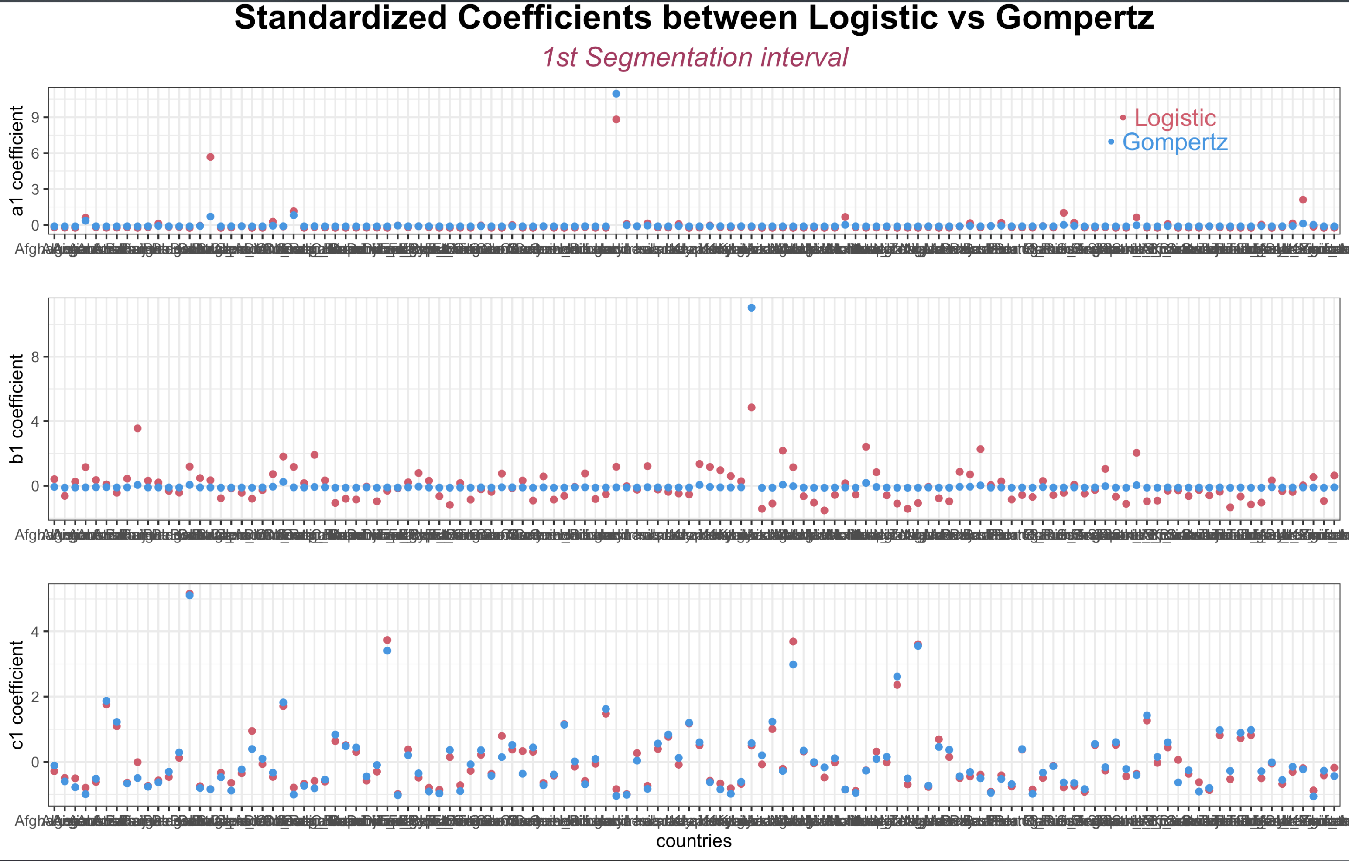
Common Coefficients for 1nd segmentation
For 2 Growth Curve Model (Logistic / Gompertz),

Slide 15
Coefficients for 2nd segmentation
For 2 Growth Curve Model (Logistic / Gompertz),
- 44 countries had been fitted commonly

Slide 16
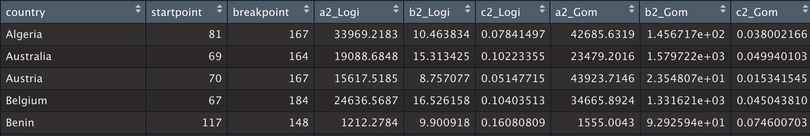
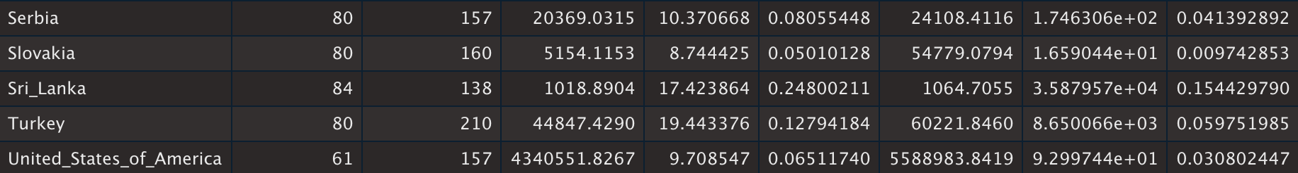
. . . . . .

Slide 17
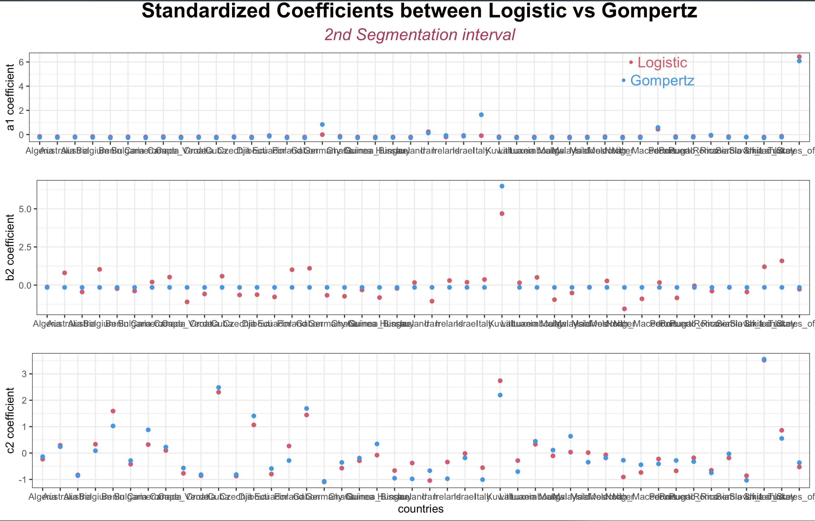
Common Coefficients for 2nd segmentation
For 2 Growth Curve Model (Logistic / Gompertz),

Slide 18
What to do next
Comparison between Separated Poisson / Logistic / Gompertz Models
(especially, coefficient C (based on the slope of each model) for Daily & Cumulative Cases)

